Slide 1

ntory Control
Inventory Control

Slide 2
Inventory Control
According to a USDA study, nationwide 46% of revenue in School Food Service is spent on food and 10% on supplies. Here in Osceola we spend 42% on food and 7% on supplies.
Controlling these costs is the focus of inventory management.
Effective inventory control begins before products are purchased.
Effective menu planning and recipe development is the first step in inventory management.
Menu planning and recipe development should utilize a minimum of products while providing enough variety to maximize customer satisfaction and good nutrition.
Procuring, forecasting, ordering, and receiving ensure that the right foods in the correct quantities are received just in time for production.
Efficient storage practices keep food secure and minimize waste.
Effective and well-organized production and service practices ensure that customers consistently receive desired foods freshly prepared, served in correct portions, and in a safe environment.
Notes:
Mona and Deborah look at the items available from USFS and try to find multiple ways to use the same products. This reduces the number of different food items we have to inventory.

Slide 3
Inventory Control
The ideal state of inventory control includes keeping enough inventory on-hand so that all items menued are available to every customer without having excess product that spoils or disappears. It also includes being able to track when, where, what and how much of each product has been received, served, or stored.
Current State
Run out of food
Overstocked
Waste/shrinkage
Ideal State
Just enough but not too much
Know exactly what products are in stock
Little waste/shrinkage
Notes:
Most cafeterias will fall somewhere in between these tow points. The goal is to make continuous improvements in order to reach an ideal state over time. In order to achieve the ideal state you have to start with the supply chain. Anyone know what a supply chain is…

Slide 4


Supply Chain
Our “internal” supply chain begins with the products that are available for us to plan our menus.
The SNS office works with the district’s Purchasing Department to develop bids or piggyback on bids for food, supplies, equipment and services. We also process USDA commodity food into ready to eat items.
Once we know the available products, menus are developed. We get input via student testing, staff input, and product evaluation/cost analysis.
Notes:
Explain Supply Chain
Explain Power Buying Group

Slide 5

Supply Chain
Once the menus have been developed we send usage requests to our distributor to ensure adequate amount are available for order.
The SNS managers are given timelines to order products and for the expected delivery of those products.
Orders reviewed by the SNS Office and then sent to the distributor on a weekly basis.
The distributor will contact the SNS office prior to delivery if there are any outages or substitutions. The SNS office will advise the distributor if a substitution is acceptable.
Deliveries are made weekly to each school cafeteria. Deliveries must be checked for errors or improperly handled food items. Invoices are signed as a indication of a complete delivery.
Notes:
Need to find USFS order/delivery calendar (from Mona)

Slide 6
Placing an Order
The first thing you need to do when starting to place your orders is to look at the historical data for the menu for which you are ordering.
Production records from similar menu days should be your starting point.
Next you will need to find out if there will be any unusual events taking place the week you are ordering for (field trips, testing, etc.).
Production records for the week you are ordering should be started and the planning columns completed.
Check your current inventory levels on your Stock Status Report in WebSmart. When you post your inventory transactions daily then your Stock Status Report should be fairly accurate.

Slide 7
Placing an Order
For USFS and Warehouse orders-
Go into WebSmart and generate your order guide for the vendor you are ordering. Print or complete the order on-line your choice.
Either enter the FS----- product number or scroll thru each page to find the items you need to order.
Once you have entered the items you need to order save your order. You can make changes as necessary until you submit it. After it is submitted changes can only be made with a new order.
Once it is released and in transit to the vendor you must complete an ADD/DELETE FORM by the Friday, before delivery, to make changes.

Slide 8
Placing an Order
Week # | Order Due Date (no later than 2:00 p.m.) | Delivery Date | Usage Week
2 | Completed | August 18 | August 24-28
3 | Completed | August 25 | August 31-Sept 4
4 | Completed | September 1 | September 8-11 (4 day order)
5 | September 2 | September 8 | September 14-18
6 | September 9 | September 15 | September 21-25
7 | September 16 | September 22 | September 28 – October 2
8 | September 23 | September 29 | October 5-9
9 | September 30 | October 6 | October 12-16 NSL WEEK
10 | October 7 | October 13 | October 19-23 (4 day order)
11 | October 14 | October 20 | October 26-30 (4 day order)
12 | October 21 | October 27 | November 2-6
13 | October 28 | November 3 | November 9-13 (4 day order)
14 | November 4 | November 10 | November 16-20

Slide 9
Placing an Order
For Orders Other Than USFS and Warehouse orders-
Produce, M & B (Milk and Juice), CiCi Pizza, and Ice Cream allow you to call or email them your order.
For these orders you should still use the same process to determine how much product you are going to need for meal service.
Historical data (from production records), unusual events and student preferences should be your guidance in placing orders.

Slide 10
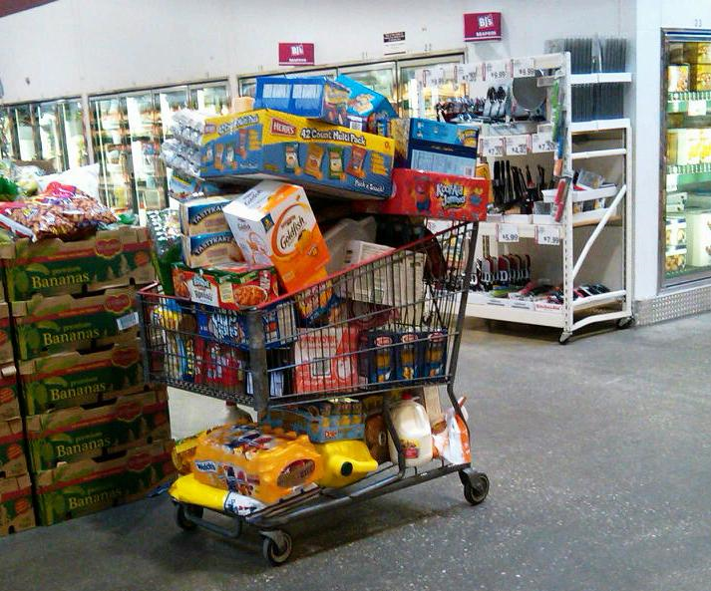
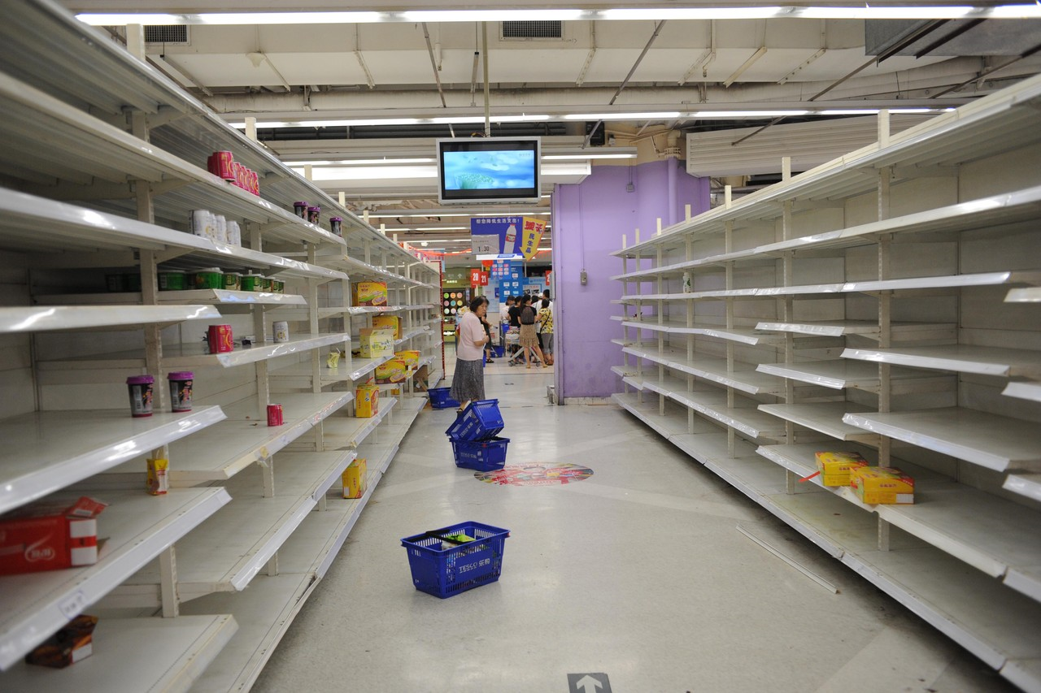
Ideal State of Inventory
Having enough product to meet the expectations of customers while being kept low enough to minimize spoilage, waste, and shrinkage.

Slide 11
Receiving Inventory
Following receiving procedures will ensure that you receive specific products that were ordered, in correct quantities, safe, and at the best quality.
Every delivery should be checked for correct quantities ordered and quality.
All deliveries must be entered into WebSmart. (Including the direct deliveries from CiCi, Ice Cream, Produce, etc.)
Notes:
The HACCP/Food Safety Manual has standard operating procedures for proper receiving.
When you are checking in orders you should have a copy of what was actually ordered.

Slide 12
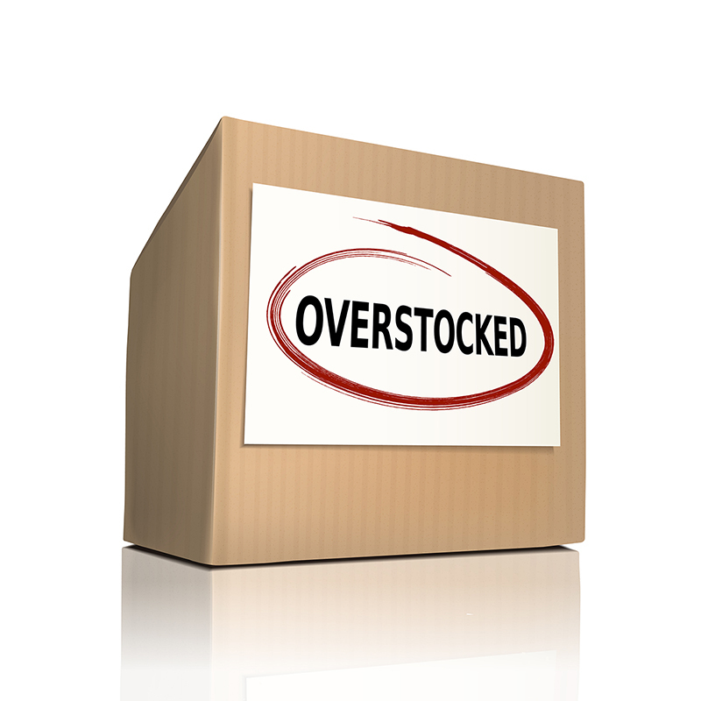
Excess Inventory/Over Ordering
Excess inventory can result in increased waste from spoilage, theft or overproduction.

Slide 13
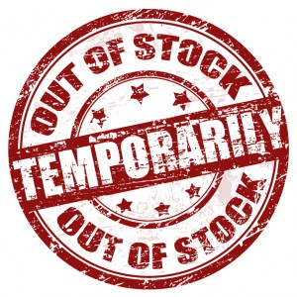
Insufficient Inventory/Under Ordering
Too little inventory is just as much a concern as excessive stock.
Good customer service is at risk, will you be able to meet the USDA regulations needed for meal service, and are you spending more money traveling to another school to borrow product are all factors when proper ordering is not followed.

Slide 14
Best Practices for Inventory Control
Use the data to forecast needs. (Student calendar, production records, unusual events, etc.)
Know your inventory levels – production records must be up-to-date by using inventory check-out sheets and item sales reports. This must be done DAILY.
Use the Order and Delivery Schedule to determine when items need to be ordered.
Never allow a delivery person to leave items without being checked.

Slide 15
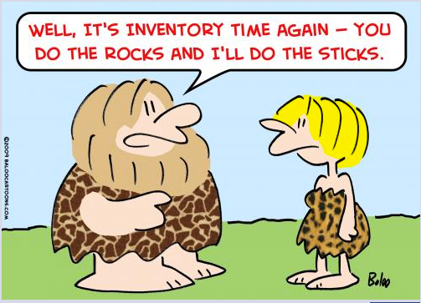
Summary
Inventory control starts with carefully planned menus, purchasing the right products in the right quantities, and making sure the items ordered are the ones received. Secure storage areas are important; in addition to accurate production forecasting and meal preparation to ensure student choices are equally important.

